Slide 1



learn invent impact
Creating Projects in Atlas
Suresh C. Kothari
Richardson Professor, Department of Electrical and Computer Engineering
President & Founder EnSoft Corp.
Acknowledgement: Team members at Iowa State University and EnSoft, DARPA contracts FA8750-12-2-0126 & FA8750-15-2-0080

Slide 2
Topics
Import existing C project or create new C project in Eclipse
Index a project in Atlas

Slide 3
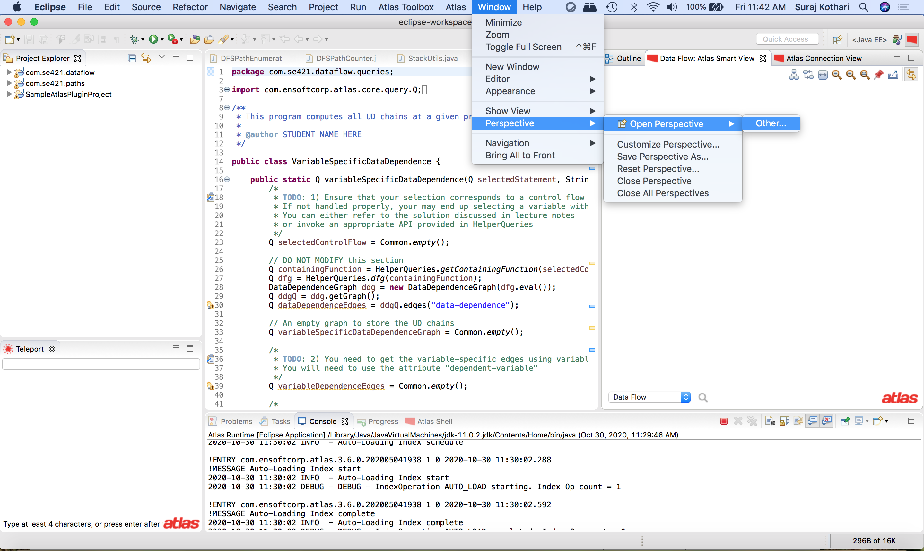
Windows
Perspectives
Select Atlas Perspective From other
After you have opened the Atlas Perspective, there will be sign for it in the upper right corner – shown on the next slide

Slide 4
Java Perspective symbol
Atlas Perspective symbol
Perspectives

Slide 5
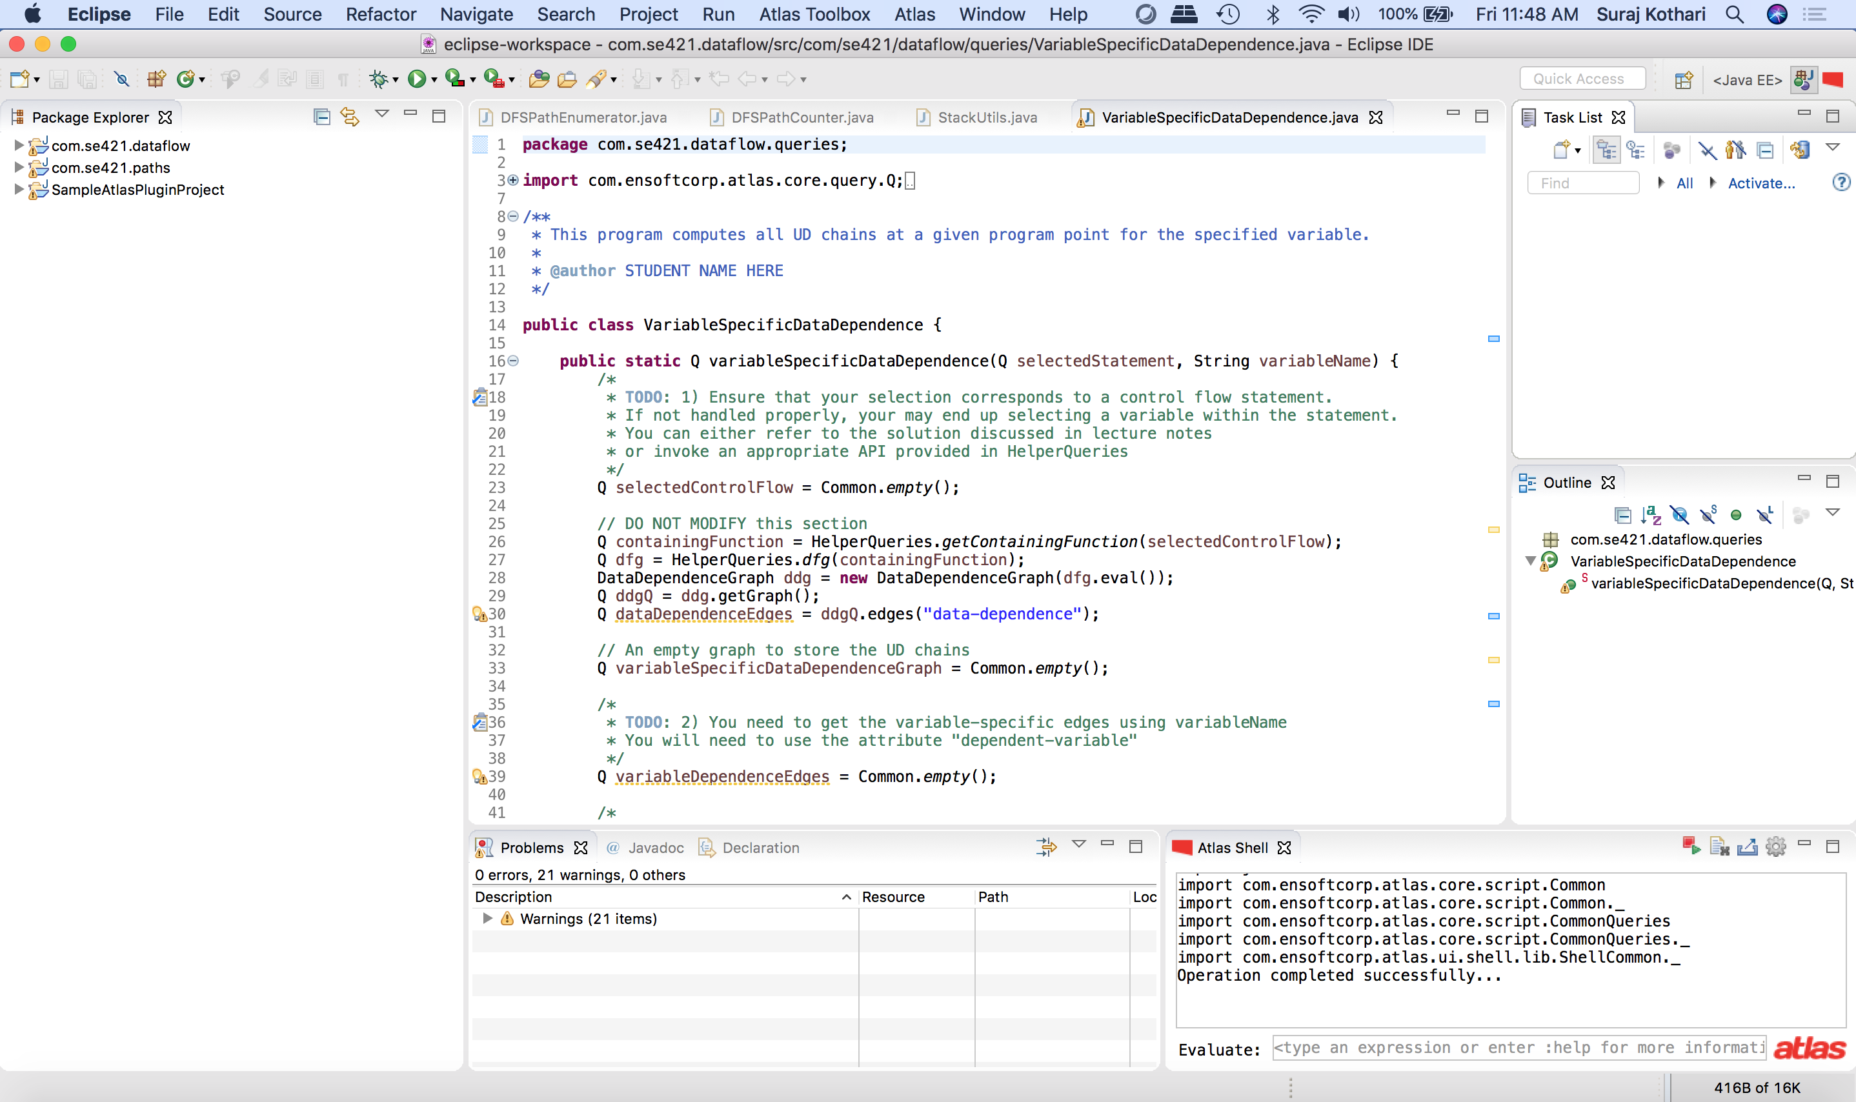
We are in Java Perspective - highlighted
After you have opened Atlas perspective, you can switch to it by clicking its symbol

Slide 6
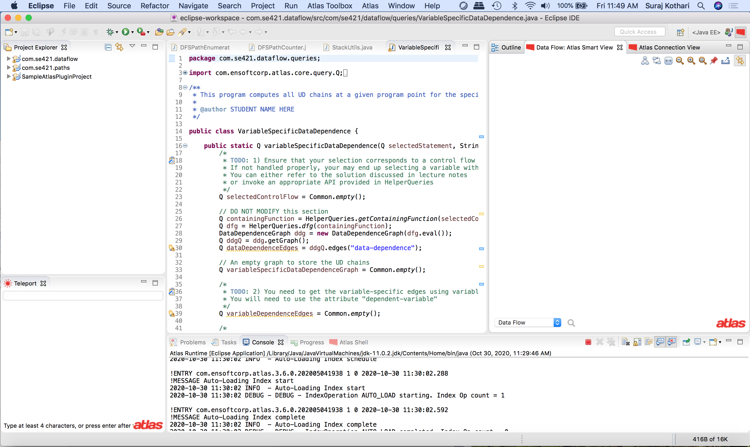
We are in Atlas Perspective - highlighted

Slide 7
Atlas Shell – Click it

Slide 8
We are in Atlas Perspective - highlighted

Slide 9
We are in Atlas Perspective - highlighted

Slide 10
Import an existing project using a local archive/directory
Scenario: You have an archive (.zip file) for an existing eclipse project.
Steps:
Note of the location of the archive.
Open Eclipse
Click File -> Import (screenshots follow)

Slide 11
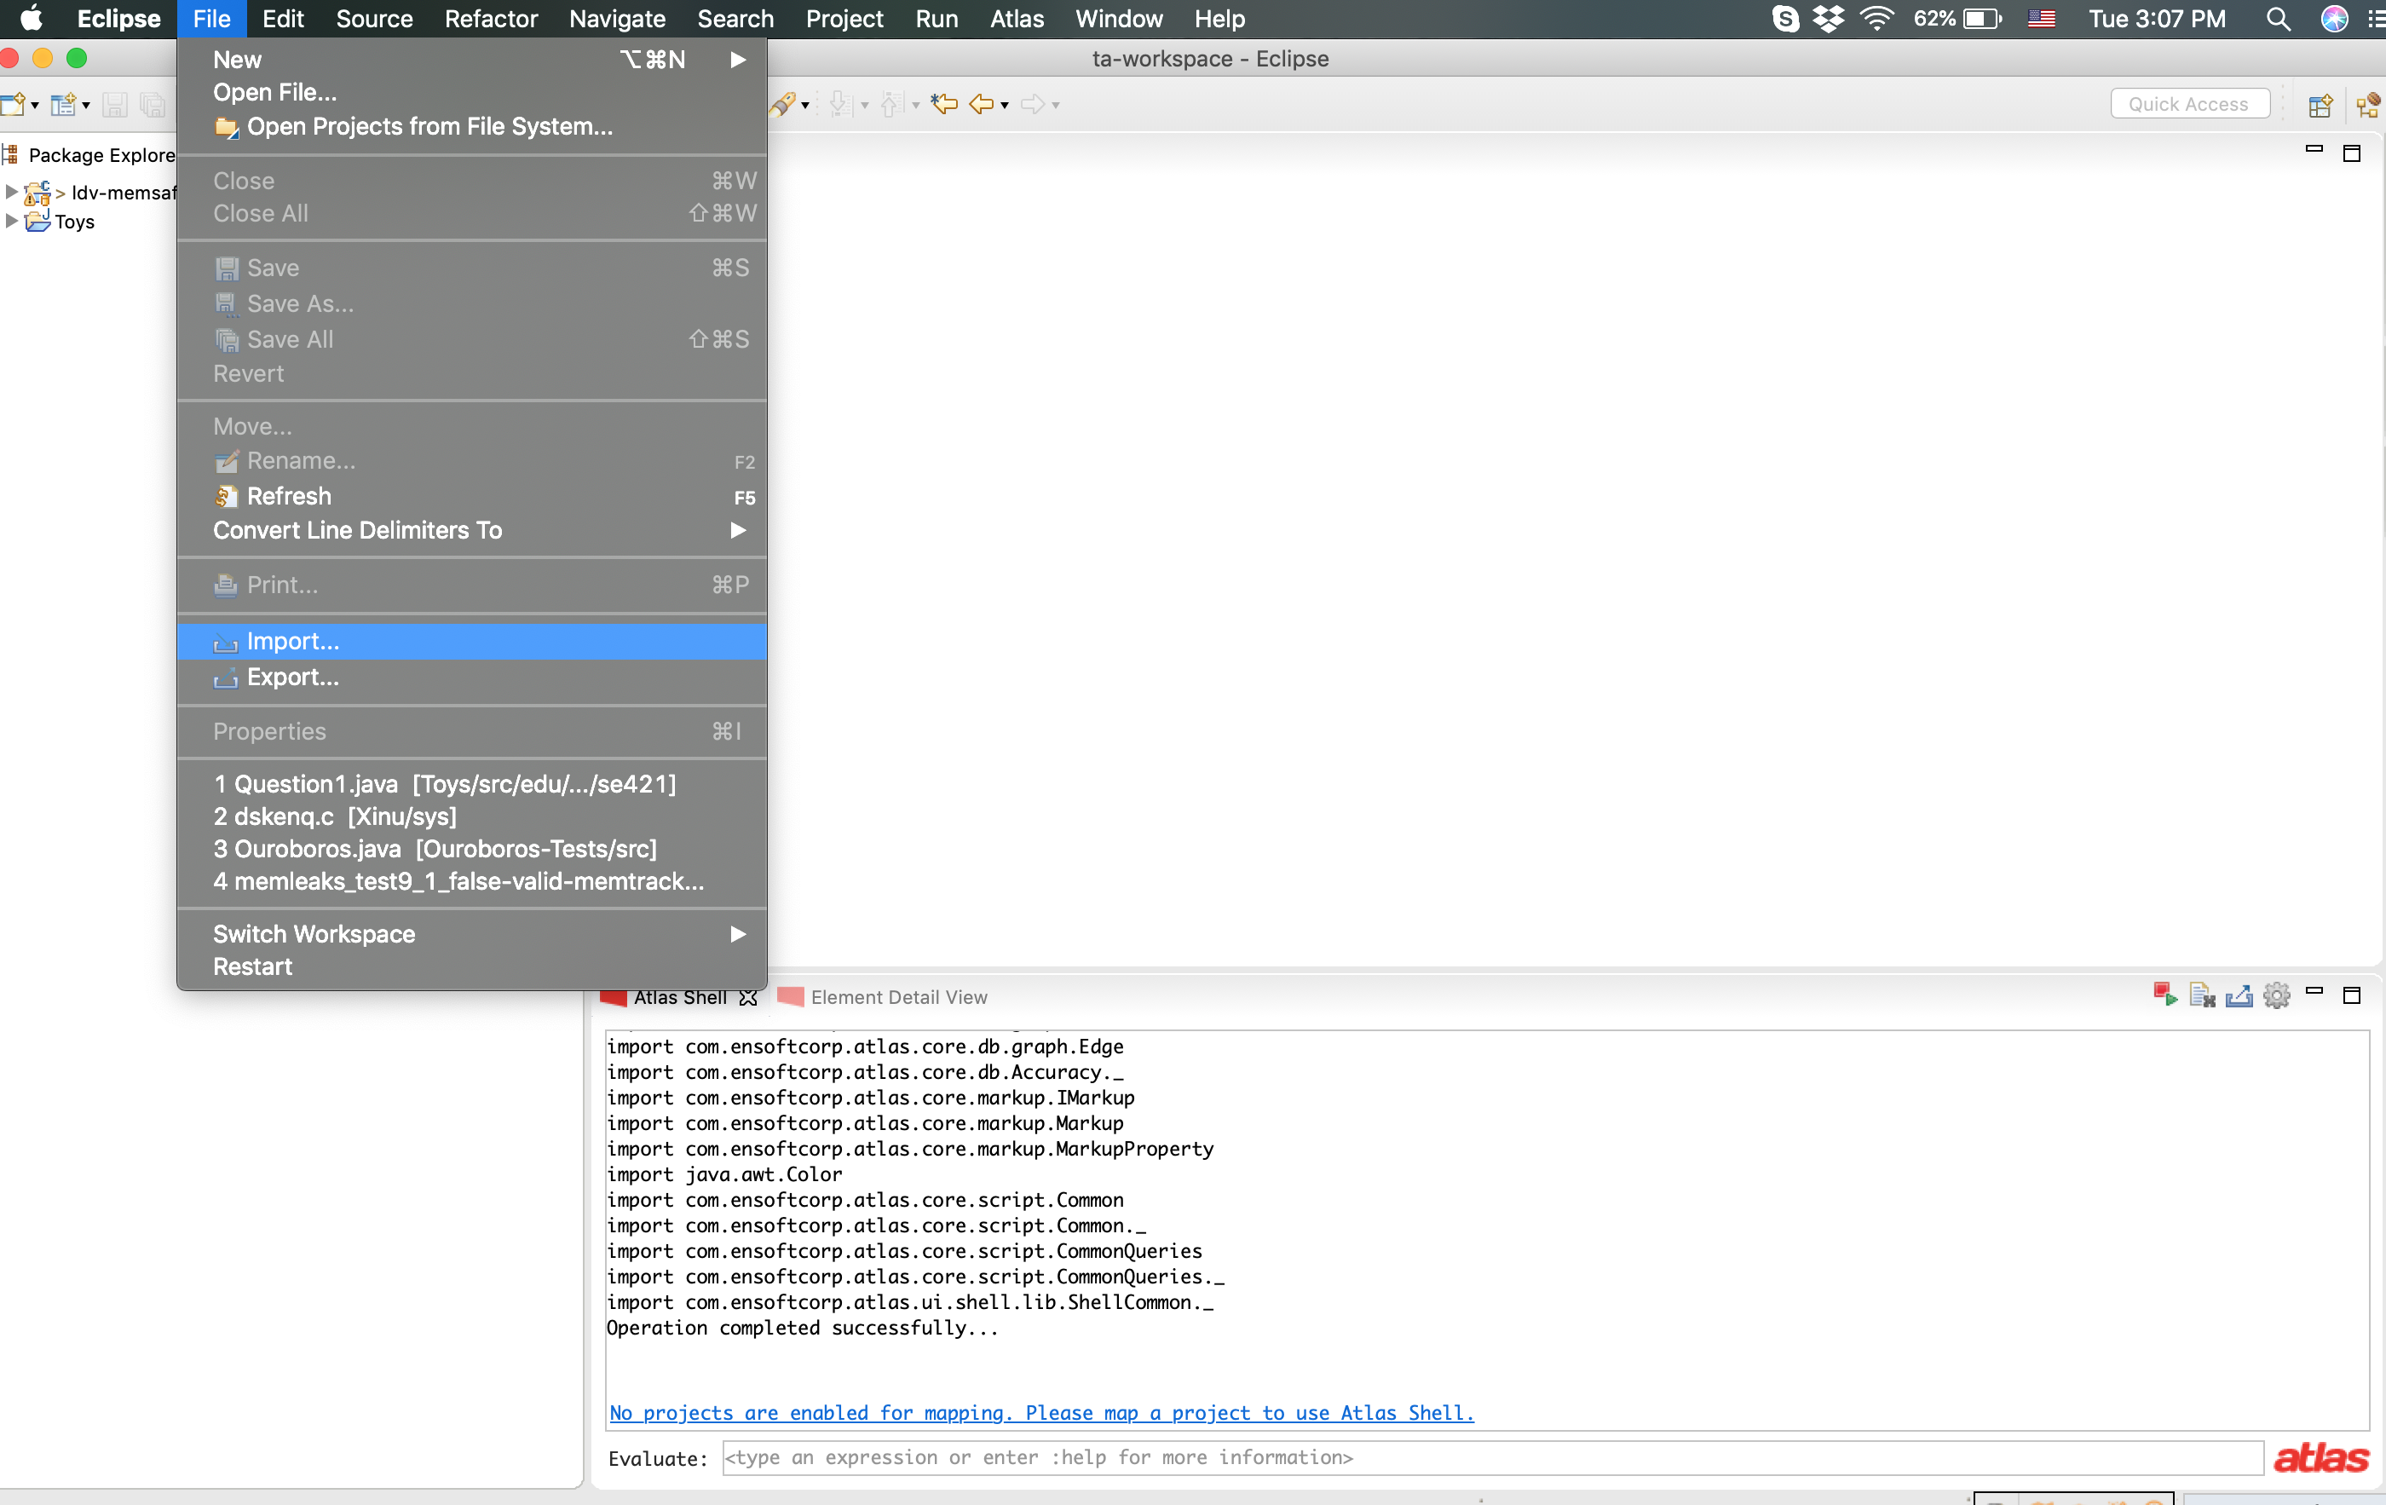

Slide 12
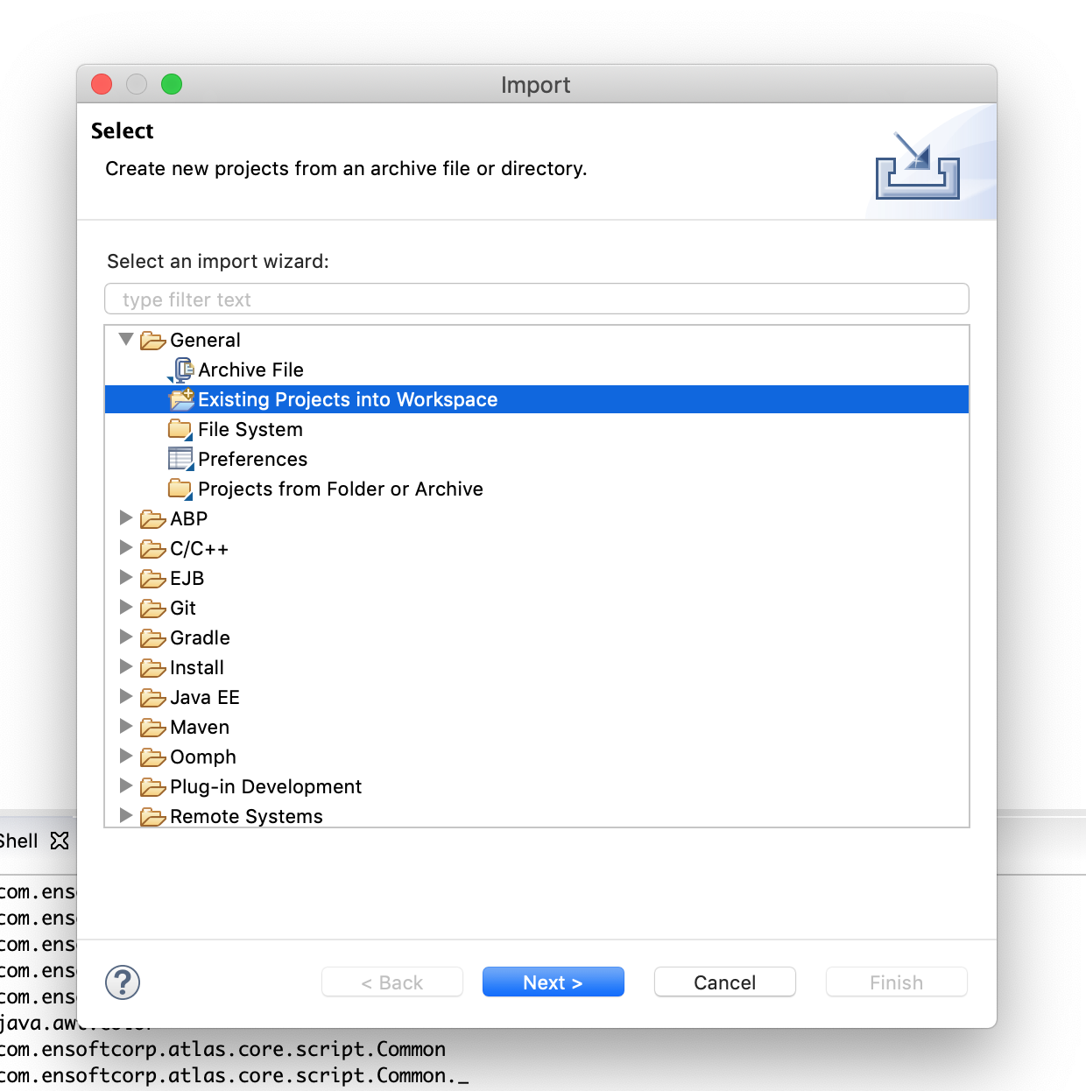
It will pop-up a window. Select Existing Projects into Workspace under General Category.
Click Next

Slide 13
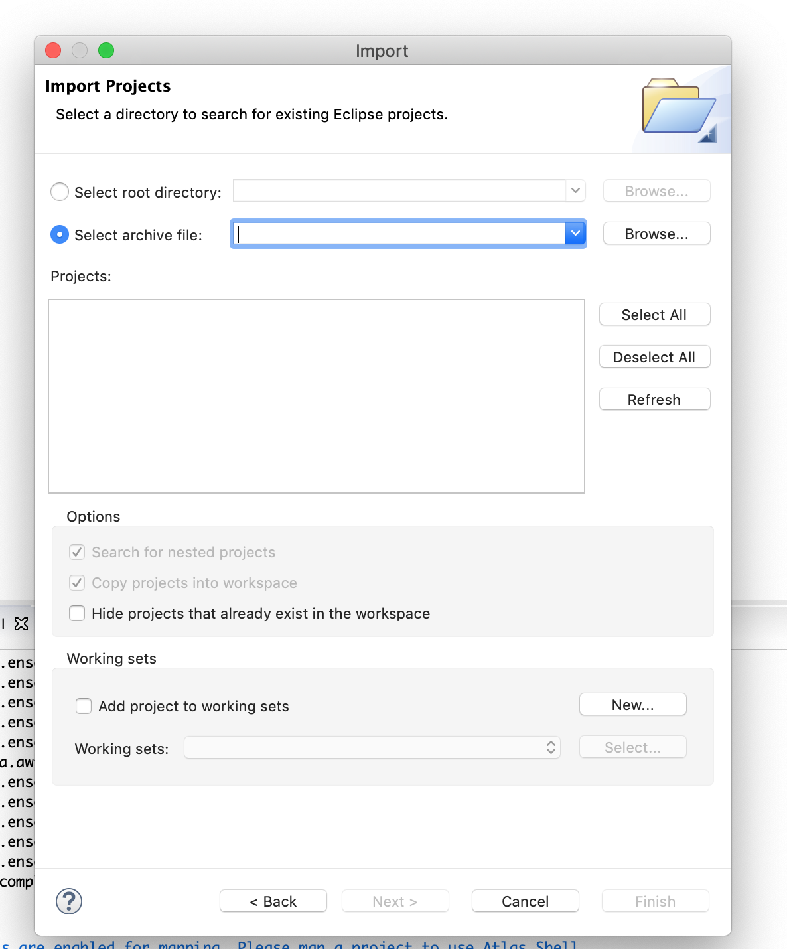
You should see a screen like this.
Click Select archive file

Slide 14
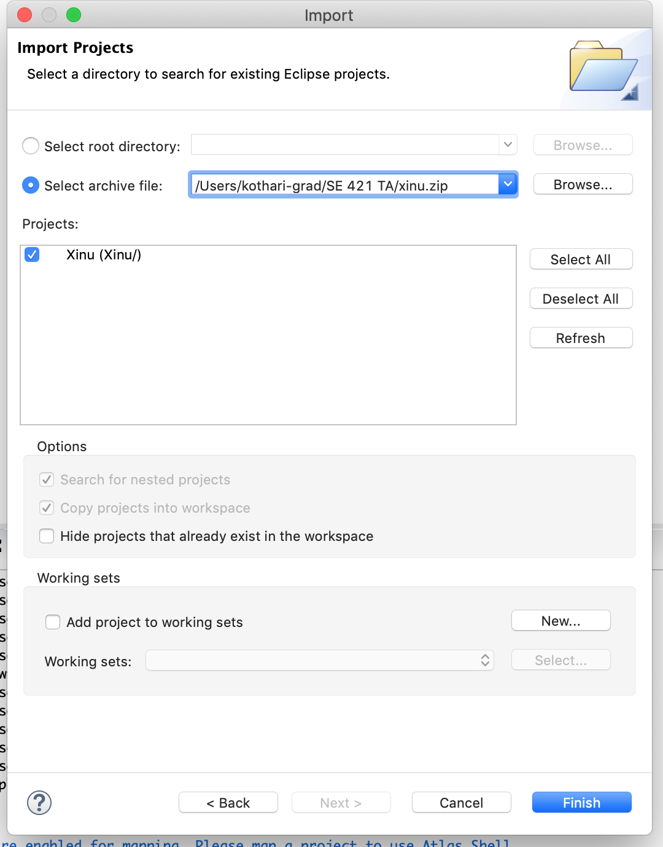
Path to Archive
Click Browse to select the archive file you’ve stored. In this case, we are selecting xinu.zip
You will see projects listed in the Projects window.
Click Finish to complete the import.
Existing Project

Slide 15
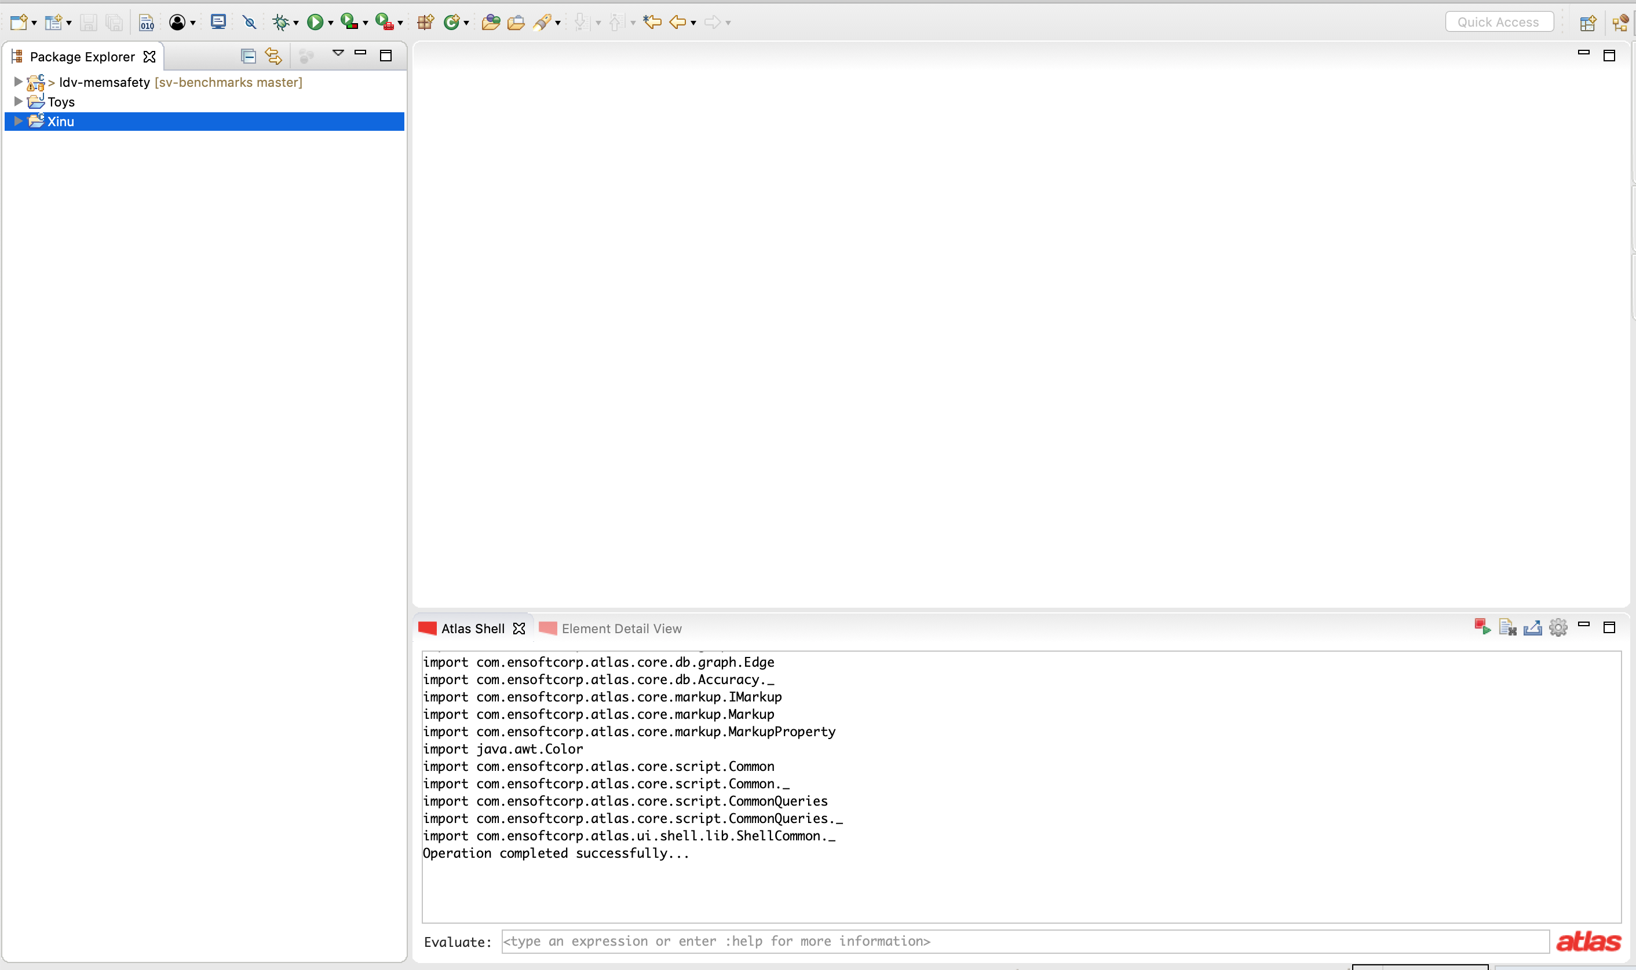
The project should show up in Package Explorer on the left

Slide 16
Create an eclipse project from a C codebase
Scenario: You want to import existing C code as an eclipse project.
We will demonstrate how to do it. The process for a Java codebase differs slightly; it is shown at the end.

Slide 17
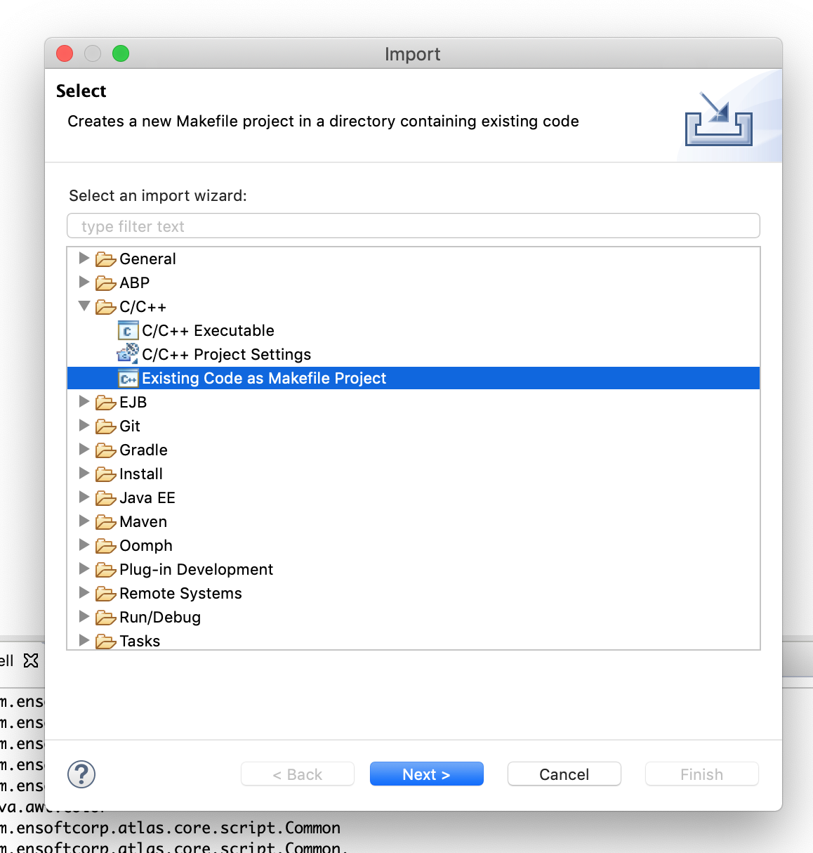
Click File -> Import to open the importing wizard (pop-up window)
This time you will select Existing Code as Makefile Project
Under C/C++ category
Click Next

Slide 18
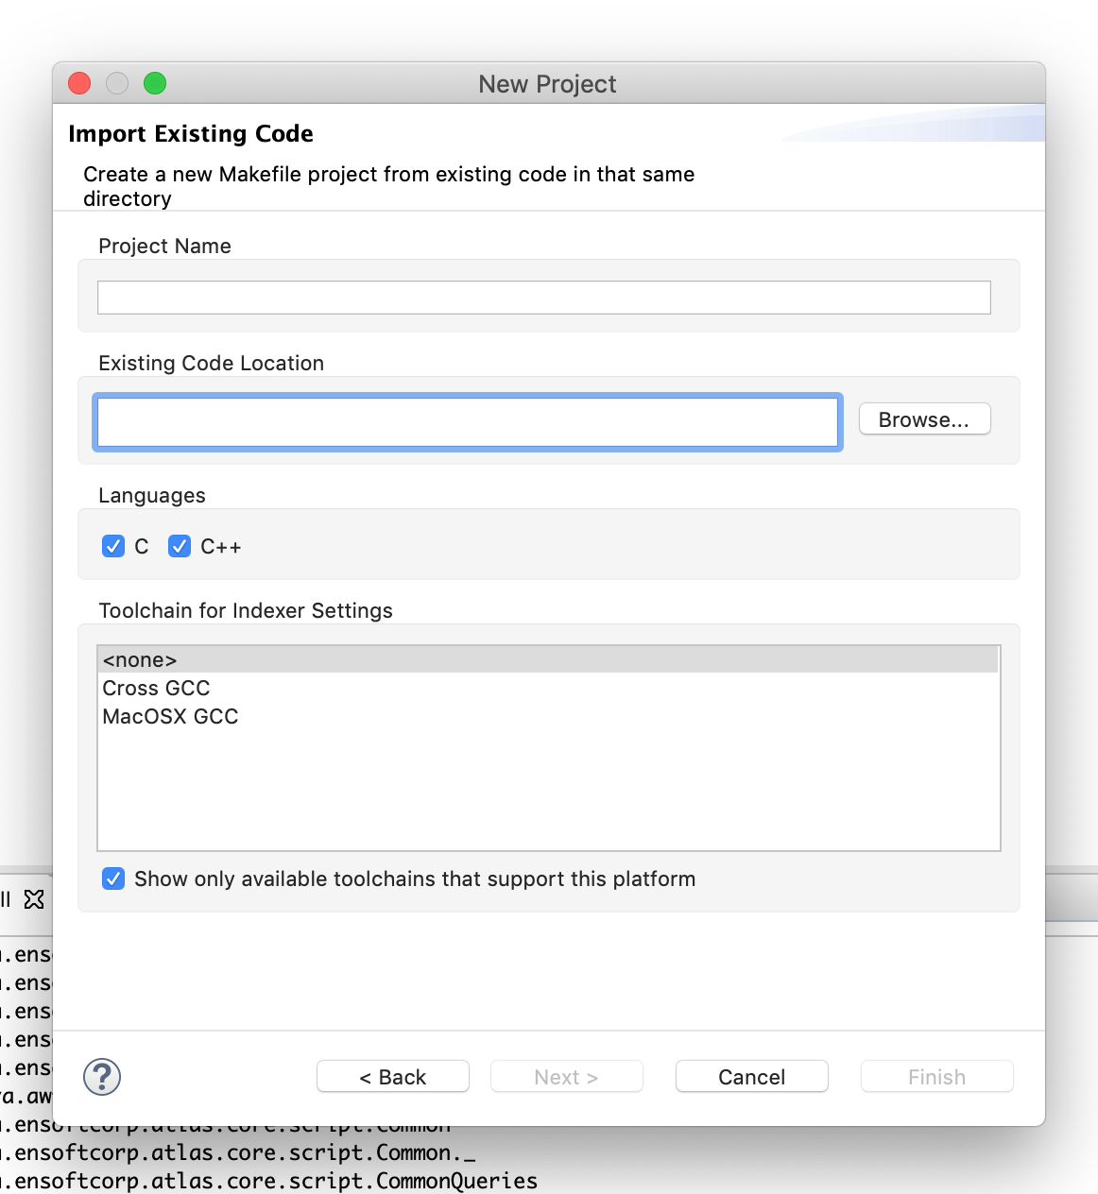
You should now see a screen like this
Click Browse to browse to the directory containing your code

Slide 19
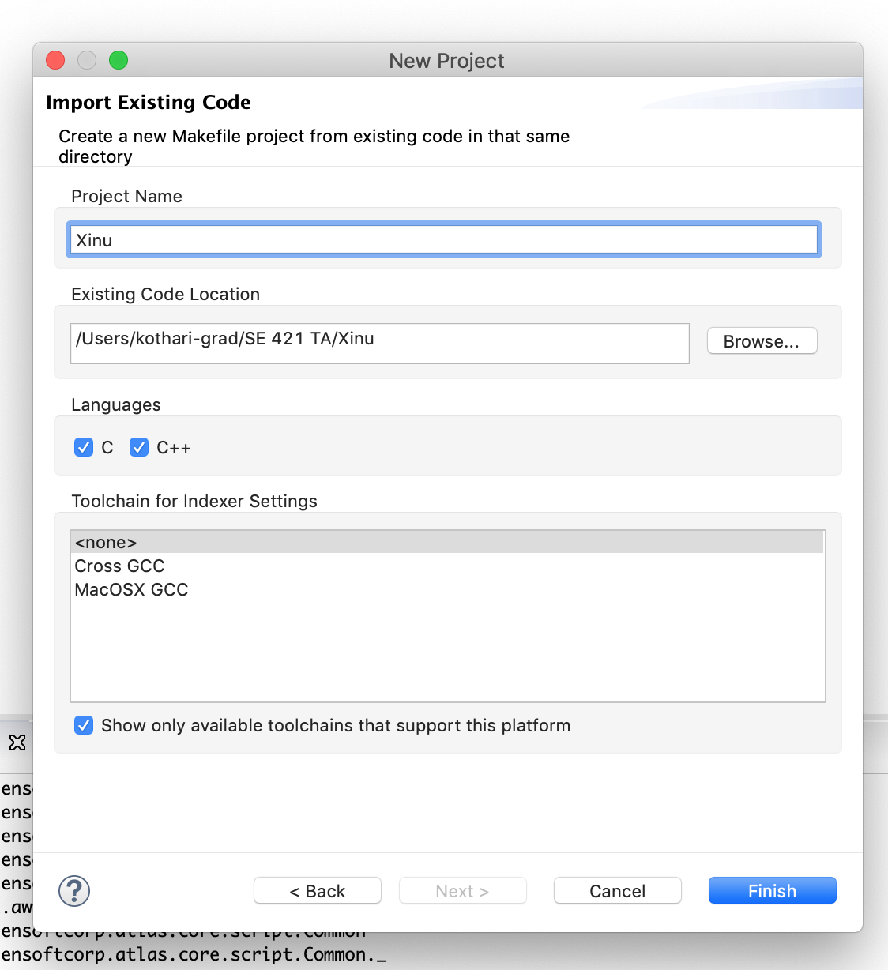
After you’ve located your code, give a name to your project. Eclipse will select the directory name as the default choice but you can edit it if you wish.
Rest of the settings can be left untouched for most of the cases. Click Finish to complete the process.

Slide 20
The project should show up in Package Explorer on the left
For Java codebases, you will select the option Projects from Folder or Archive
under General category in the import pop-up window.
Rest of the process is the same.

Slide 21
Indexing a project into Atlas
After you’ve imported a codebase into eclipse, next step is to index it into Atlas. We will demonstrate how to do it. When you index a project into Atlas, Atlas will process the codebase and generate a graph database for it.

Slide 22
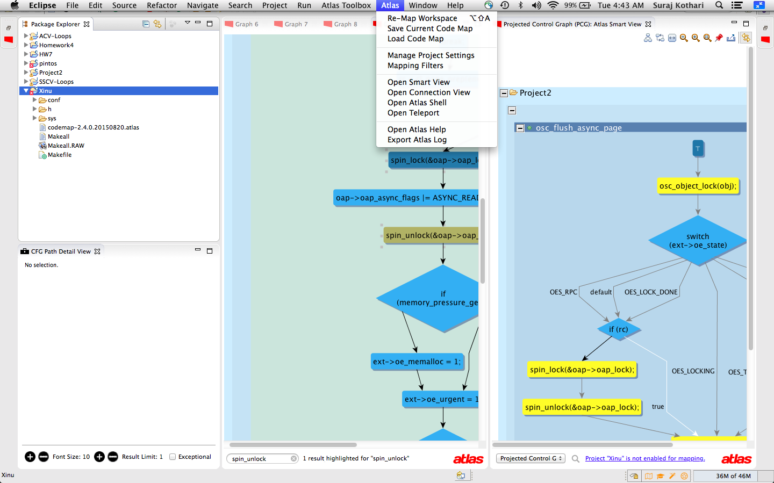
Hover to top of the screen to get the top bar.
Select Mange Project Settings from the Atlas menu.

Slide 23
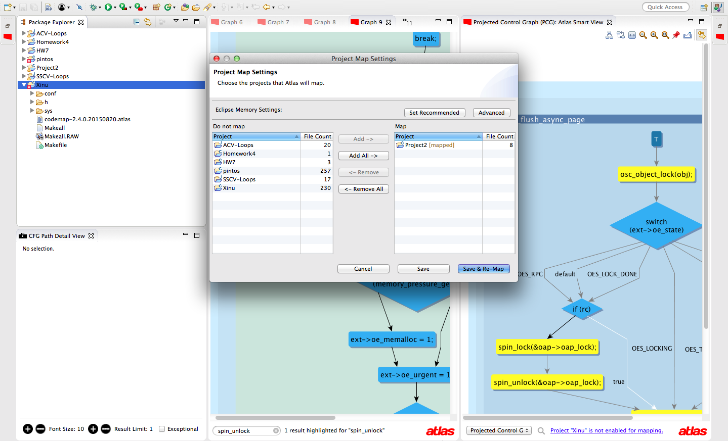

Slide 24
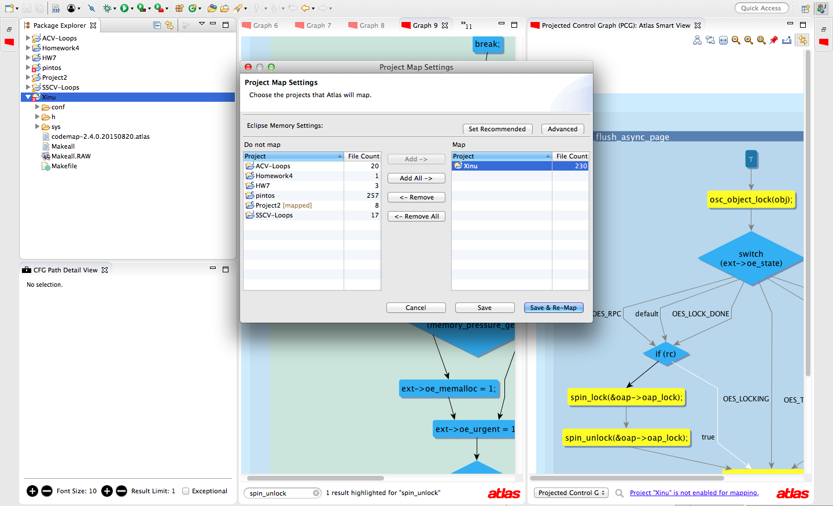
The previous step opens the
Project Map Settings menu.
Remove current project(s),
if you’ve any.
Add the Xinu project (the project we wish to index)
Click the Save & Re-Map button.

Slide 25
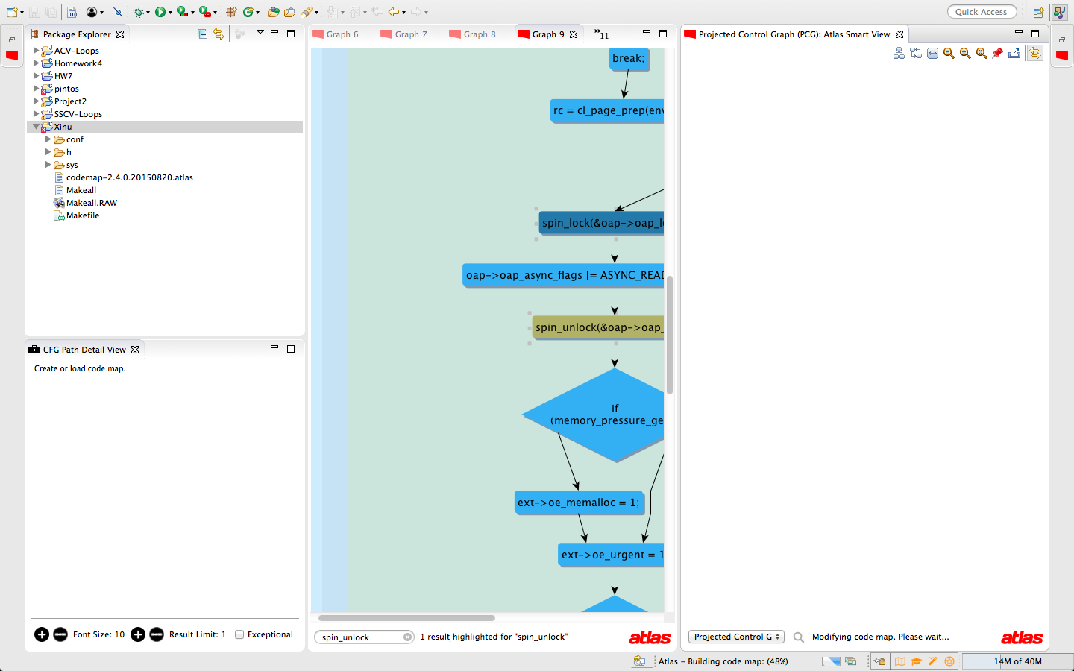
Effect of Re-Map: Atlas starts generating the index (i.e. the graph database) for the new project. The progress is shown. It is currently 48% done. Once it reaches 100%, it is indexed and you’re ready to start analyzing it using Atlas

